Slide 1
Movie Collection.
Logistic Regression analysis.

Slide 2
Index.
Introduction.
Tools Used
Import Data and Cleaning.
Data Analysis:
Distribution of collection
Outlier Detection
Outlier Treatment.
Distribution of movies on the basis of collection.
Market expenses basis of Genre.
Production expenses.
Director Rating.
3D movies.
Dummies.
Conclusion.

Slide 3
Introduction.
We are looking forward to work with movie collection dataset. Our target variable is “Start Tech Oscar”. According to the data set we have multiple independent variables such as collection, marketing expense, production expenses, Multiplex coverage, budget, movie length, Actor and actress rating, director and producer rating etc.
As this is a binary outcome. We decided to use logistic regression to predict the model. Logistic regression specially used when there is a binary outcome.
Our main goal is to predict whether the movie will get the star tech Oscar or no. For this there is various factors come to picture.
We also done analysing various other variable to understand the dataset better.

Slide 4
Tools used.
We have only used one tool that is python.
Using visual studio code, we have interpreted the result.
Using scikit learn we have run the logistic regression model to interpret the results.

Slide 5
Import Data and Cleaning.
We have imported the data in visual studio code. We discovered that we have data type in int and float and object types.
There was 12 null values in Time taken column. We have removed the null values as it was less than 3%.
There was no duplicate values present. The data was almost clean without any noise.

Slide 6
Data Analysis.
In data analysis part, we have studding various variable in python.
We have used seaborn library and matplotlib to visualize the data.
There are few outliers which has been collected and also treated them accordingly.
There is various colour palate has been used to make the visuals more attractive.

Slide 7
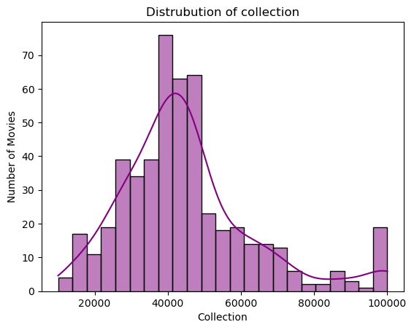
Data Analysis. Distribution of collection
Most of the movies are concentrated between 35000 to 450000.
The distribution is positively skewed that means most of the outlier are detected on the right hand side
There are few collection of movies which is close to 100000. We should further investigate for potential outliers.

Slide 8
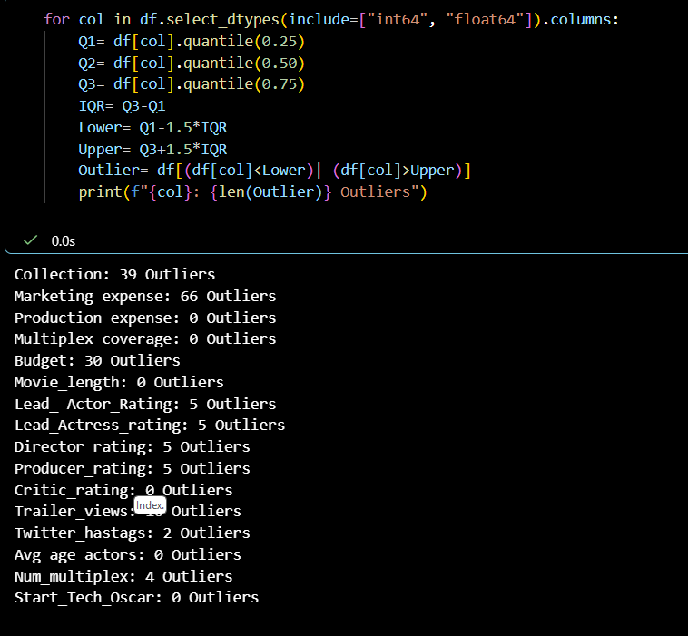
Data Analysis. Outlier Detection
Collection has 39 Outliers
Marketing Expenses has 66 Outlier
We are going to treat this outlier as this has an extreme value rest of the outlier we are leaving as it is

Slide 9
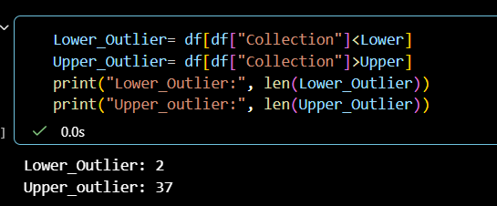
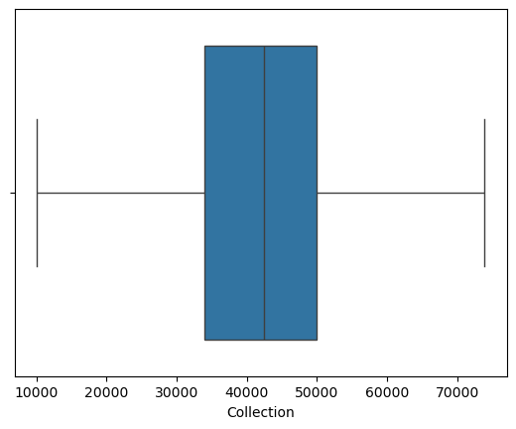
Outliers Treatment.
In collection we can see that there are 2 in lower fence and 37 in upper fence. This outlier is going to treated using clip method.
Clip means the values of the lower limit become lower limit and the value of upper limit becomes upper limit.
After treating the outlier in the second image we can see that there is no more outlier and we can analysis data without any noise.

Slide 10
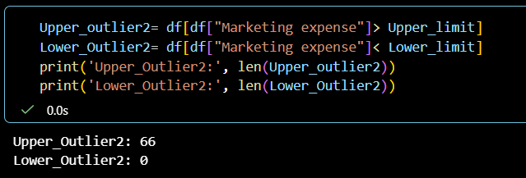
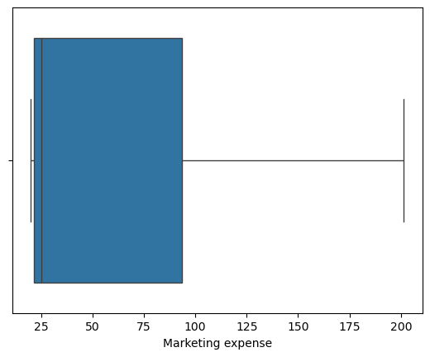
Data Analysis. Outlier Treatment.
Secondly we can see there is an outlier in marketing expense and the upper Outlier is 66.
We have treated this with clip and now there wont be an outlier for marketing expense.
If we check the below image there is no outlier that means our data for marketing expense is clean.

Slide 11
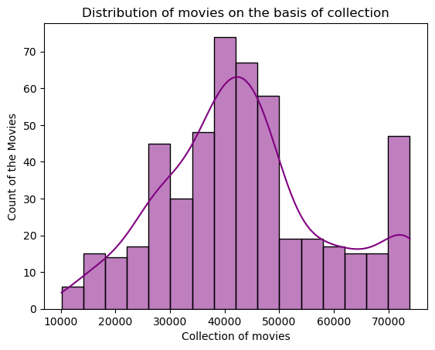
Distribution of movies on the basis of collection.
We have this normal distribution for collection as we have treated the outliers
We have detect that 25000 to 45000 there are most of the movies are created.
We have also see that around 70000 to 750000 there is 40 to 40 movies which is created.

Slide 12
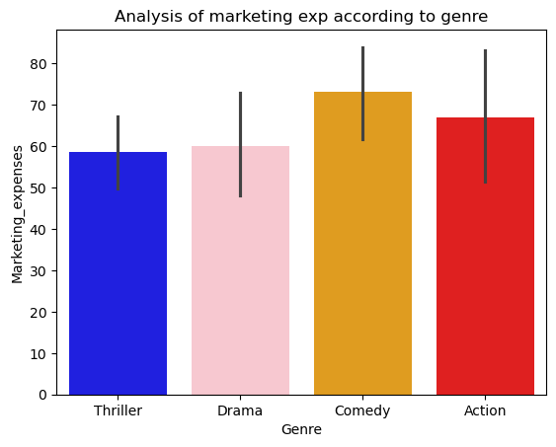
Market expenses basis of Genre.
We can observe that there is more expense for comedy and action.
Thriller and drama has almost similar market expense.

Slide 13
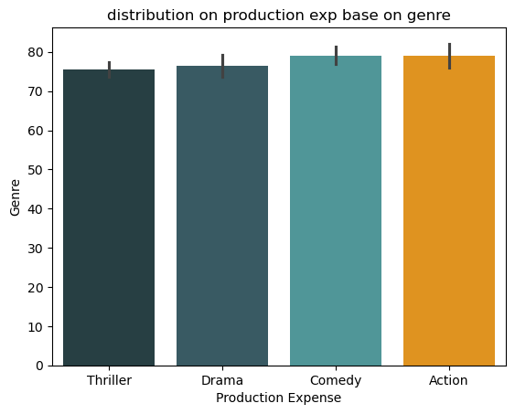
Production expenses.
Here we can interpret that most of the production exp is done for action and comedy.

Slide 14
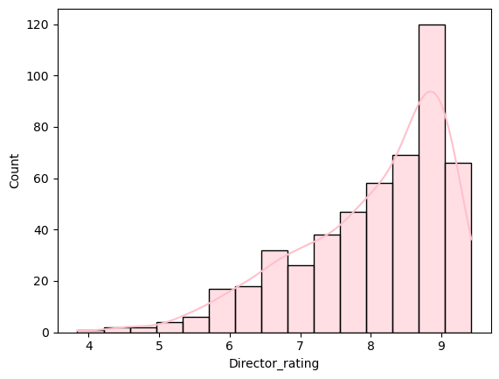
Director Rating.
Most of the directed are rated between 8 to 9.
As this image also shows that the count of the movies is also high, the once which comes within the range of 8 to 9.5.

Slide 15
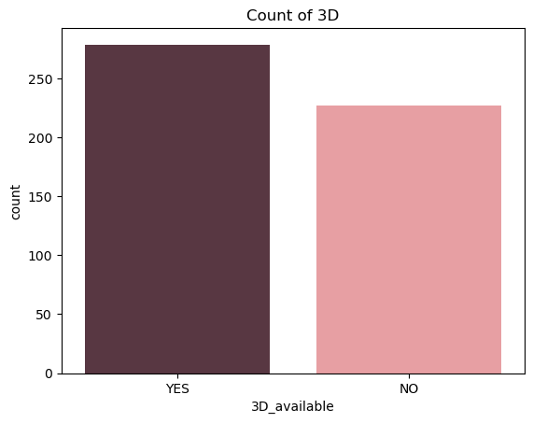
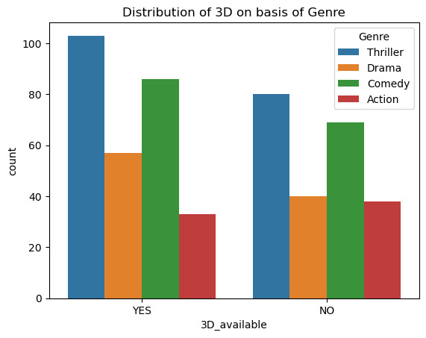
3D movies.
According to the visuals, we can see that there is more count for 3D movies.
As thriller movie is topping the chart and also comedy movies are yes to 3D movies.
On other hand drama and action movies are tens be less for 3D creation.

Slide 16
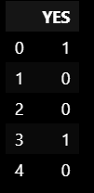
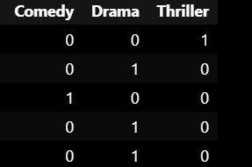
Dummies.
We have created dummy variable for genre and 3D_available.

Slide 17
Logistic Regression.
Based on the classification report you showed, your model can be interpreted as follows.
Your model's performance
Overall:
Accuracy = 0.59 (59%)
Macro F1 = 0.58
Weighted F1 = 0.59
Test set size = 167
Metric | Class 0 | Class 1
Precision | 0.66 | 0.51
Recall | 0.57 | 0.61
F1-score | 0.61 | 0.55
Number of samples | 96 | 71

Slide 18
Conclusion.
The model demonstrates moderate but limited classification performance. It achieved an accuracy of 59% on the test set, with F1-scores of 0.61 and 0.55 for classes 0 and 1, respectively. Although the model identifies 61% of the actual class-1 observations, its precision for class 1 is relatively low at 51%. Furthermore, the accuracy is only slightly higher than the majority-class baseline of approximately 57.5%, suggesting that the model provides limited improvement over a simple baseline classifier.

